Slide 1
MODELING HOW INVESTMENT MANAGERS AND CLIENTS CAN WORK BETTER TOGETHER QWAFAFEW BOSTON March 18, 2025 REFERENCE: AGENT INVESTING: A CONSTRUCTIVE APPROACH, WITH STEVE SATCHELL, JPM FEB 2025
Jarrod Wilcox, William Zieff

Slide 2
Professional Investing Will Keep Changing
Just as in fields like law, medicine, and education, the investing price of commonplace intelligence will fall as AI is implemented …
… putting a premium on the specialized intelligence needed for forming and managing agent-investor relationships.

Slide 3
Agent Investing
Quantitative academic theory and research are most often framed from the investor’s viewpoint
Agent business objectives and experience are not integrated into quantitative models that evaluate mutual benefit
A More Constructive Approach:
A quantitative framework for evaluating agent-investor relationships based on mutual benefit and the maximization of coalition utility
Notes:
* simple model can provide some deep insights
Marketing “pitch” about the pivot

Slide 4
Investing Coalition Model Approach
Single-period, single agent-investor pair
Both parties are risk averse
Each party constructs utility from return distributions: fee-based business return for the agent
Feasible coalitions meet each expected utility minimum
Maximize a linear weighting of expected utilities

Slide 5
Calculating Agent Return From Investment Return
Agent fees
A. pro-rata fee on beginning assets
B. same fee rate applied to period change in assets
C. shadow fee based on agent Δ forecast of future fees
H. hedge fund-like incentive fee
Agent Return on Business Assets:
(A+B+C+H) / Size Relative to Investor Portfolio

Slide 6
Calculating Coalition Expected Utility
Candidate
Asset Allocation
Agent View
Investment Returns
Investor View
Returns
Business Returns
Agent Utility
Investor Utility
Coalition Utility
Expected Utility

Slide 7
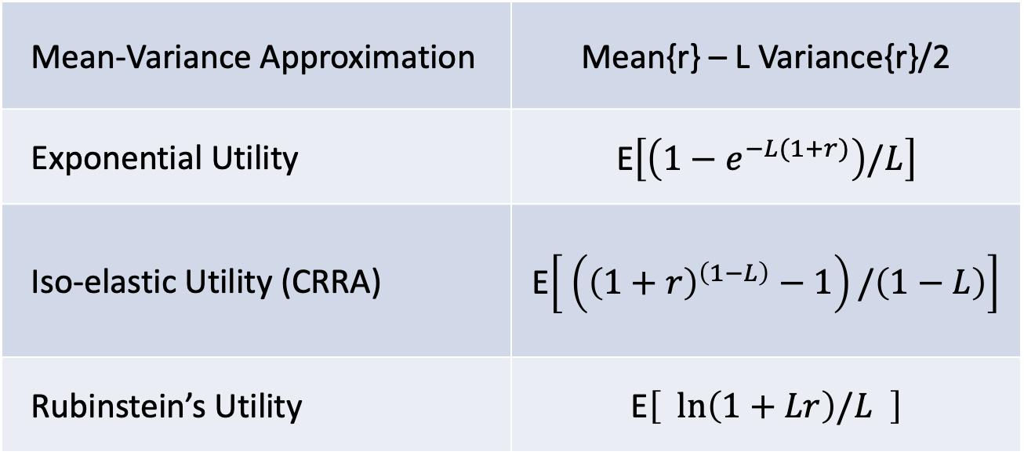
Approaches to Expected Utility of Return r
Mean-Variance Approximation | Mean{r} – L Variance{r}/2
Exponential Utility | E$\left[\left(1−e^{−L(1+r)}\right)/L\right]$
Iso-elastic Utility (CRRA) | E$\left[ \left({\left(1+r\right)}^{\left(1−L\right)}−1\right)/\left(1−L\right)\right]$
Rubinstein’s Utility | E$\left[ \ln\left(1+Lr\right)/L \right]$

Slide 8
Risk Aversion Parameter: L
With L at value of 4 or less and modest fat-tailed risks, similar optimal portfolios are produced using each of the utility approaches.
Estimating L
From questionnaires based on preferences for hypothetical choices
The ratio of portfolio value to maximum tolerable loss (discretionary wealth)

Slide 9
One Way to Set Risk Aversion L
What is the greatest fractional investment loss you can endure in a year without it being a personal disaster?
As a good start, simply invert:
L ~ 1/max loss fraction

Slide 10
Shiller Historical Data for Modeling Returns 1,825 Observations and Estimates
 | MONTHLY TOTAL RETURN CHARACTERISTICS
 |  |  |  |  |  | CORRELATIONS
 | ASSET |  | MEAN | STDEV |  | STOCK* | BOND* | CASH**
 | STOCK* |  | 0.0081 | 0.0406 |  | 1 | 0.04 | -0.01
 | BOND* |  | 0.0039 | 0.0127 |  | 0.04 | 1 | 0.01
 | CASH** |  | 0.0012 | 0.0026 |  | -0.01 | 0.01 | 1
 | * Source: Shiller [2023]
 | ** Proxy generated from return characteristics of VWSTX

Slide 11
Scenarios Presented
 | Fee | Size | Benchmark | Incentive
Agent
Social Utility Weight | 0.5 | 0.5 | 0.5 | 0.5
Utility Function | Isoelastic | Isoelastic | Isoelastic | Isoelastic
Risk Aversion L | 4 | 4 | 4 | 4
Period Length (M's) | 1 | 1 | 1 | 3
Net Fee | 0 to .0009 | 0.0004 | 0.0004 | 0.0010
Relative Agent Asset Size | 0.1 | 1 to .001 | 1 to .001 | 10 to .001
Forecast Fee Delta (M's /1%) | 1 | 0,1 | 1 | 1
Promise | 0.005 | 0.004 | 0.004 | 0.015
Return Components | ABC | ABC | ABC, ABR | ABCH
Investor
Social Utility Weight | 0.5 | 0.5 | 0.5 | 0.5
Utility Function | Markowitz | Markowitz | Markowitz | Exponential
Risk Aversion L | 4 | 3 | 3 | 3
Period Length (M's) | 1 | 1 | 1 | 3
Net Fee | 0 to .0009 | 0.0004 | 0.0004 | 0.0010
.

Slide 12
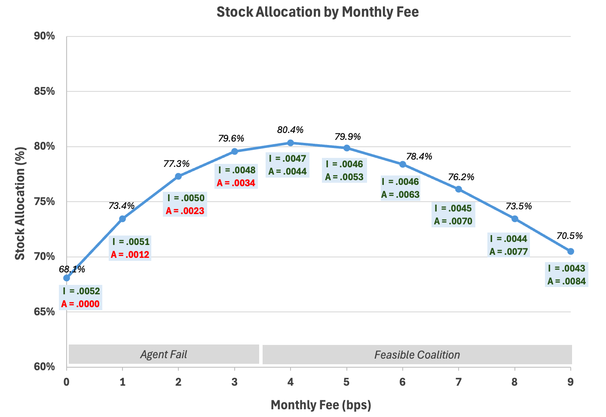
Scenario: Fee

Slide 13
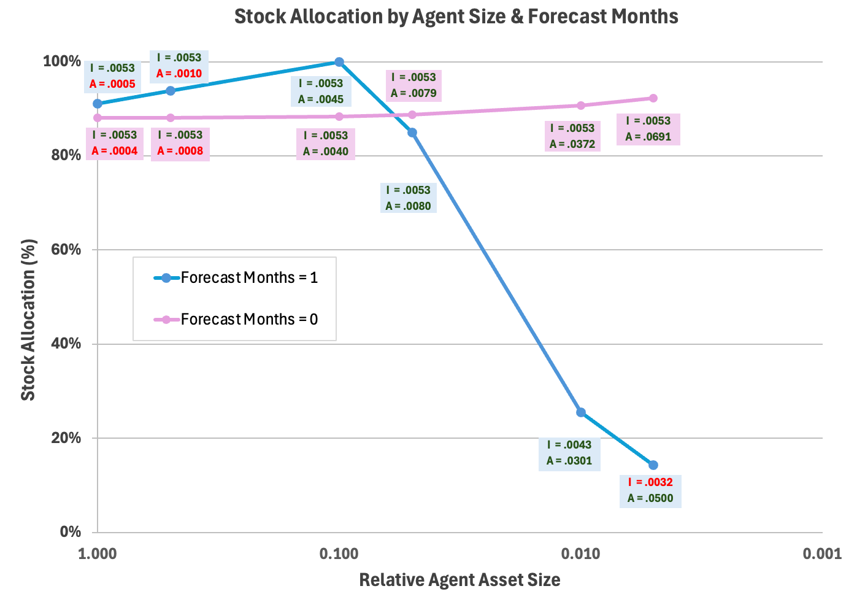
Scenario: Relative Agent Asset Size

Slide 14
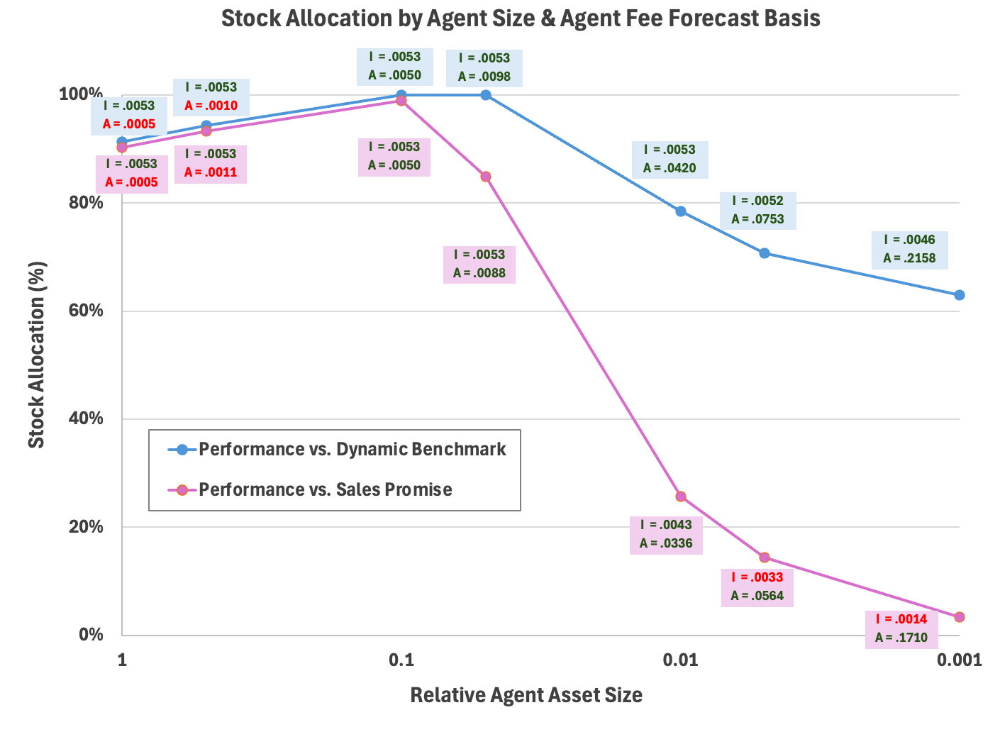
Scenario: Fixed vs Dynamic Benchmark

Slide 15
Scenario: Incentive Fee
Stock Allocation by Agent Size with Incentive Fee
Agent Fail
Investor Fail

Slide 16
Emergent Behavior
Higher asset-based fees first tilt agents toward higher-return, higher-risk allocations but very high fees induce moderation.
Agent committed asset size matters because it, along with cost of service, controls fee-based business return mean and standard deviation
Dynamic benchmarks improve coalition stability.
Hedge fund-like incentive fees can over-stimulate risk-taking and produce negative portfolio return skewness

Slide 17
Common Performance Measurement Falls Short
Agent asset allocation relies on forecasts of both portfolio results and perceived investor response
Forecasts that integrate risk are usually needed to reflect investor needs
Even the Sharpe Ratio—and other measures not based on expected utility – may do so inaccurately
Industry performance reporting frequently…
Makes it harder to engage with clients to have them consider, build intuition, and understand risk
Proposals on this topic have been made, but limited uptake so far

Slide 18
Better Performance Measurement
Performance measures continually communicate perceived investor needs to the agent
Comparing risk-adjusted portfolio return to a risk-adjusted dynamic benchmark is practical—if a risk aversion parameter L is explicitly agreed upon
M-V example: Mean{r-b) – (L/2)(Variance{r} – Variance{b})
Single-period Rubinstein example: ln[(1+Lr)/(1+Lb)] / L
Potential Results:
More stable relationships because wider feasible coalition range
More opportunity for agents to add value through risk reduction

Slide 19
Practical Applications Today
Selecting Clients or Managers: Right partner return, right benchmark
Agreeing on Utility Function: CRRA or Rubinstein
Agreeing on Risk Aversion: try the discretionary wealth approach to assessment even with other utility approaches
Beware Naive Incentive Compensation: Use more realistic simulation and employ fairer risk-adjusted incentives

Slide 20
Future Research Potential
For theory:
Modeling S-curve risk-seeking behavior
Situate within a competitive market of agents and clients
For practice:
Cost of service and non-return client benefits
Consider how diversification of agent’s book of business might affect risk-taking with any individual client
Taxes and inflation
Multi-period? Example: successful managers becoming more conservative

Slide 21
Conclusions
A relatively simple coalition model offers useful insights into policies for improving agent-investor relationships
Each party in a successful coalition needs a satisfactory risk-adjusted return on committed assets
Both parties share responsibility for accurate communication of their needs
Risk-adjusted performance measurement looks attractive for improving communication

