Slide 1
Systematic Equity Strategies as Sources of Risk
Stanislav Radchenko
April 2014

Slide 2
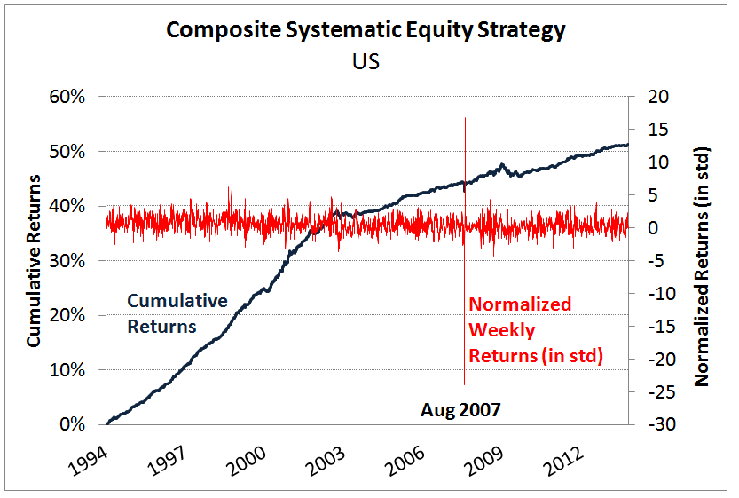
Systematic Equity Strategies Proxy For Crowded Trades

Slide 3
Agenda
What are Systematic Equity Strategies (SES)?
SES and crowding
Risk implications of SES: Selected Examples
Risk forecasting benefits of SES
Conclusions

Slide 4
Systematic Equity Strategies
“Systematic Equity Strategies” (SES) refer to the systematic (i.e., computer-based or rules-based) implementation of fundamental or technical equity investment anomalies & strategies
Motivated by investment or economic insight
Documented in academic finance literature
Have a wide following among finance professionals

Slide 5
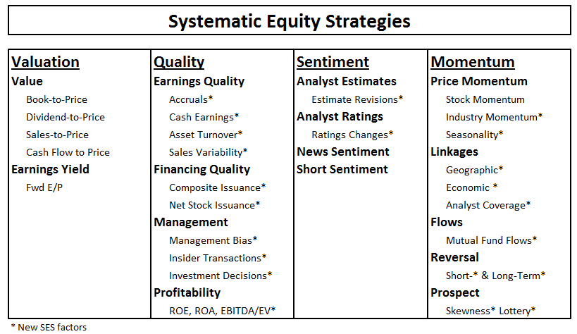
What are They?
Composite of factors represents underlying strategy

Slide 6
Systematic Equity Strategies in US
New Factors | Short Description
Earnings Quality | Composite of cash earnings, accruals, variability in sales
Profitability | Composite of profit margin, EBITDA/EV, ROA, and ROE
Asset Turnover | Sales over total assets
Sentiment | Composite of consensus estimate revisions and analyst rating changes
Seasonality | Heston-Sadka seasonality
Prospect | Composite of skewness, lottery, and drawdown
Industry Momentum | 6 month GICS sub-industry momentum (20 day half life)
Long-Term Reversal | 4 year reversal in stock returns excluding last 13 months
Short-Term Reversal | 1 month reversal in stock returns

Slide 7
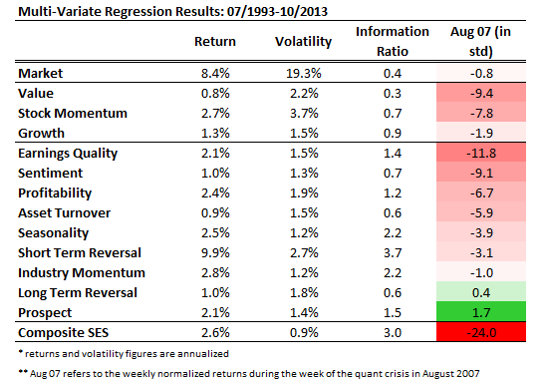
Systematic Equity Strategy Performance in US
Most SES experienced negative performance during quant crisis of 2007

Slide 8
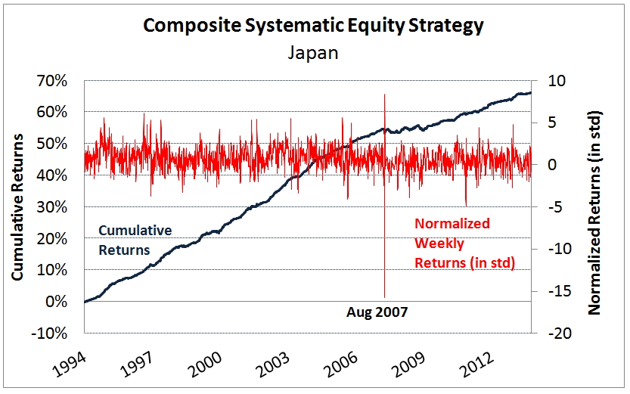
Good Proxy For Crowded Trades - Japan

Slide 9
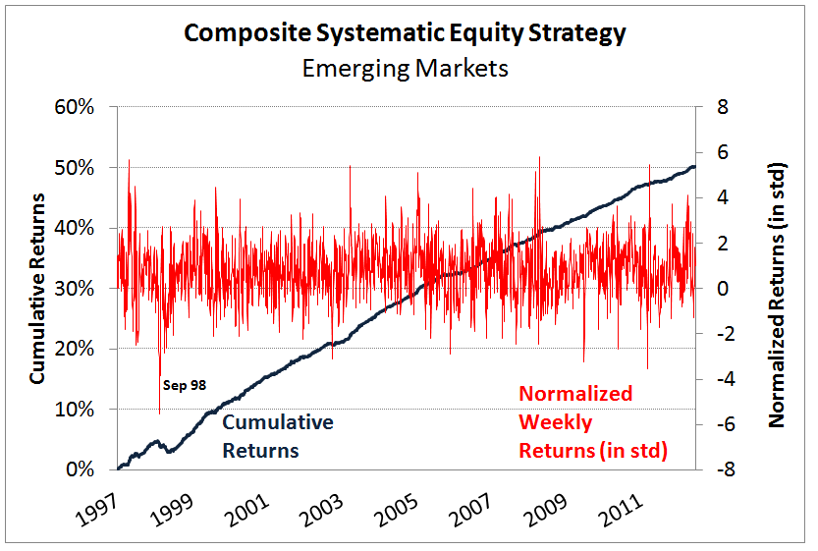
Good Proxy For Crowded Trades – Emerging Markets

Slide 10
Risk Implication of Systematic Equity Strategies – Selected Examples

Slide 11
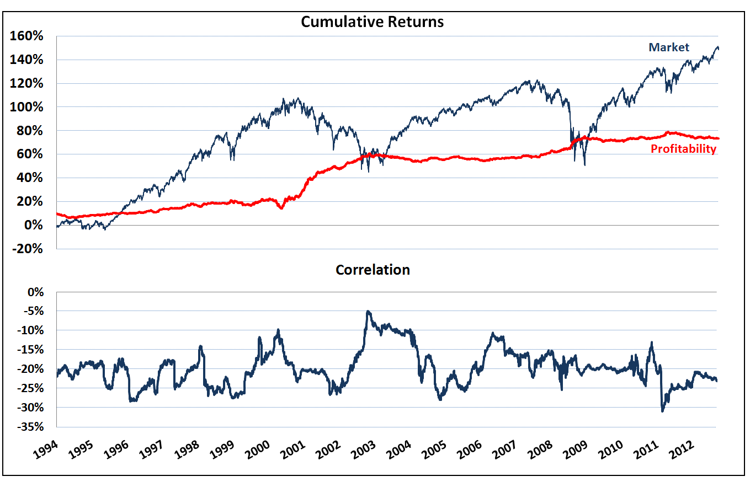
Market & Profitability in US
Profitability is negative correlation with the market

Slide 12
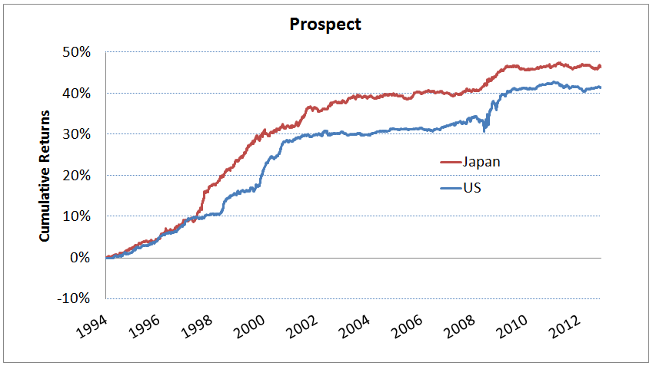
Prospect Factor Performance (by Selected Countries)
Long firms with high prospect scores, short firms with low prospect scores

Slide 13
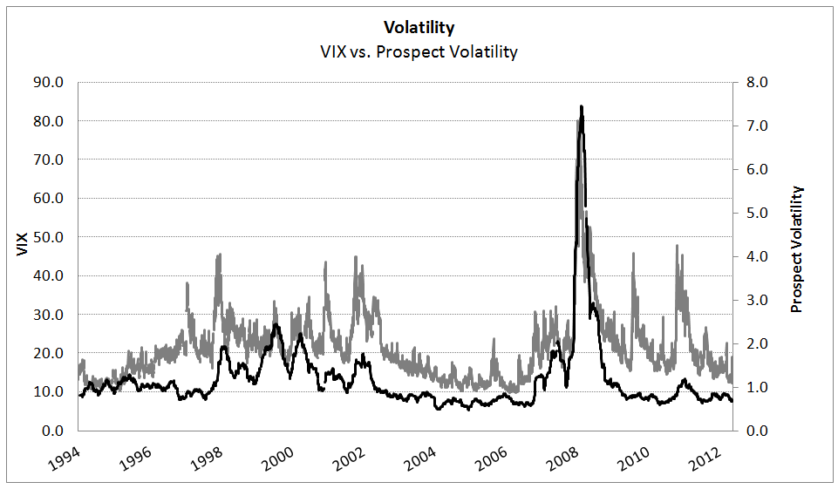
Prospect Factor Risk (by Selected Countries)
Volatility spiked during the financial crisis period

Slide 14
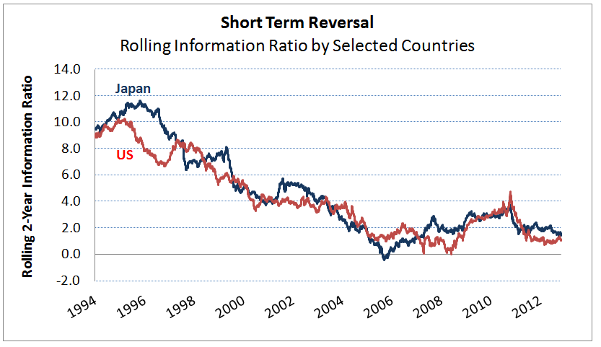
Short Term Reversal (by Selected Countries)
Long firms with poor recent performance, short firms with strong recent performance

Slide 15
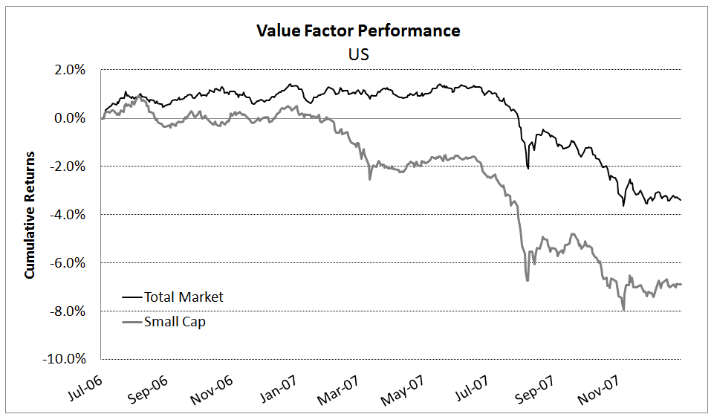
Small Cap vs. Total Market Value Factor
Value factor performance started to diverge during early 2007

Slide 16
Tail Risk Factors: Slow Composite
“Slow” factors in the composite use estimation window of 126 – 252 days excluding most recent 2 months
Going long stock with high tail risk estimates
Lower partial moment: stock returns volatility conditional on stock return to be below a certain threshold
Total stock returns and specific returns
Hybrid tail covariance risk: covariance of stock returns with the market conditional on stock return to be below a certain threshold
Total returns and specific returns
Downside Beta: covariance of stock returns with the market conditional on market return to be below a certain threshold
Coskewness

Slide 17
Tail Risk Factors: Slow Composite Results (PRELIMINARY)
Multivariate Performance
Univariate Quantile Performance
Multivariate performance (IR):
Daily cross-sectional regressions: IR = 1.10
Monthly cross-sectional regressions: IR = 1.14

Slide 18
Tail Risk Factors: Fast Composite
“Fast” factors in the composite use estimation window of < 42 days
Going long stock with high tail risk estimates
‘Fast’ lower partial moment: stock returns volatility conditional on stock return to be below a certain threshold
Total stock returns and specific stock returns
Reversal effect for ‘fast’ tail risk composite

Slide 19
Tail Risk Factors: Fast Composite Results (PRELIMINARY)
Multivariate Performance
Univariate Quantile Performance
Multivariate performance (IR):
Daily cross-sectional regressions: IR = -2.94
Monthly cross-sectional regressions: IR = -1.34

Slide 20
Systematic Equity Strategies – Risk Forecasting Benefits

Slide 21
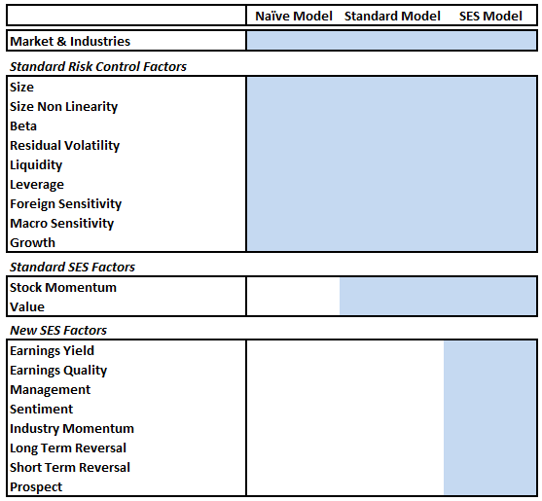
Use Alternative Models to Isolate Benefits
Naïve Model excludes all of SES factors and uses standard risk/control factors
Standard Model excludes SES factors except for Stock Momentum and Value
SES Model includes all of the SES factors

Slide 22
Risk Prediction & SES Factors
Interested in models’ risk predictions for the following three managers:
Manager I: Valuation Strategy
Manager II: Valuation & Momentum Strategy
Manager III: Valuation, Momentum, Sentiment & Quality Strategy

Slide 23
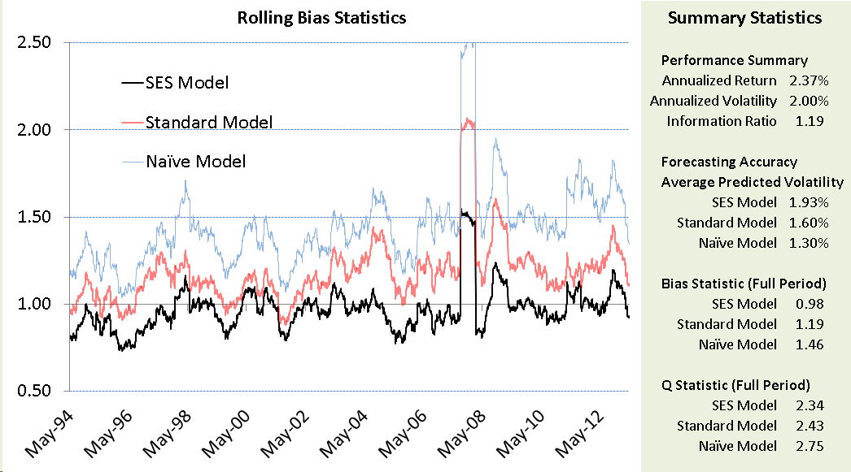
SES Model Improved Risk Forecasts I
Manager I
Persistent under prediction of strategy risk using Naïve (46%) and Standard (19%) risk models

Slide 24
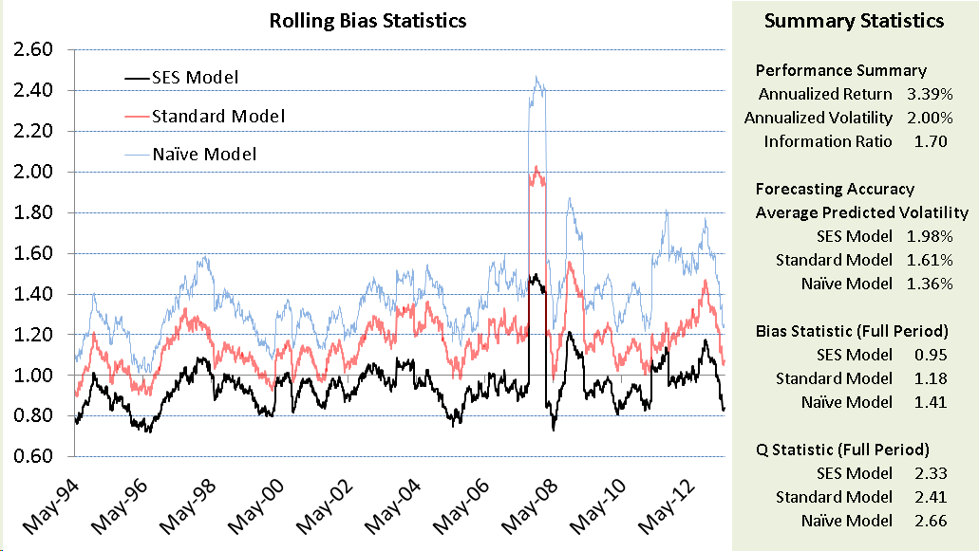
SES Model Improved Risk Forecasts II
Manager II
Persistent under prediction of strategy risk using Naïve (41%) and Standard (18%) risk models

Slide 25
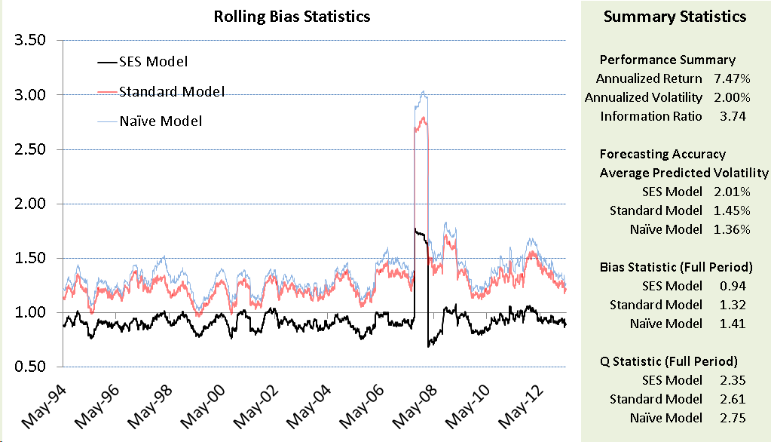
SES Model Improved Risk Forecasts III
Manager III
Persistent under prediction of strategy risk using Naïve (41%) and Standard (32%) risk models

Slide 26
SES Model Improved Risk Forecasts IV
Significant under prediction of portfolio risk using Naïve or Standard risk models

Slide 27
Conclusions
Systematic Equity Strategies may be used to measure exposure to potentially crowded factors/trades
SES factors offer useful economic insights about portfolio risk
SES improve risk forecasts of portfolio managers that tilt on these strategies

Slide 28
MSCI 24 Hour Global Client Service
Americas
Americas 1.888.588.4567 (toll free)
Atlanta +1.404.551.3212
Boston +1.617.532.0920
Chicago +1.312.706.4999
Monterrey +52.81.1253.4020
Montreal +1.514.847.7506
New York +1.212.804.3901
San Francisco +1.415.836.8800
São Paulo +55.11.3706.1360
Stamford +1.203.325.5630
Toronto +1.416.628.1007
Europe, Middle East & Africa
Cape Town +27.21.673.0100
Frankfurt +49.69.133.859.00
Geneva +41.22.817.9777
London +44.20.7618.2222
Milan +39.02.5849.0415
Paris 0800.91.59.17 (toll free)
Asia Pacific
China North 10800.852.1032 (toll free)
China South 10800.152.1032 (toll free)
Hong Kong +852.2844.9333
Seoul 00798.8521.3392 (toll free)
Singapore 800.852.3749 (toll free)
Sydney +61.2.9033.9333
Taiwan 008.0112.7513 (toll free)
Tokyo +81.3.5226.8222
clientservice@msci.com | www.msci.com

Slide 29
Notice and Disclaimer
This document and all of the information contained in it, including without limitation all text, data, graphs, charts (collectively, the “Information”) is the property of MSCI Inc. or its subsidiaries (collectively, “MSCI”), or MSCI’s licensors, direct or indirect suppliers or any third party involved in making or compiling any Information (collectively, with MSCI, the “Information Providers”) and is provided for informational purposes only. The Information may not be reproduced or redisseminated in whole or in part without prior written permission from MSCI.
The Information may not be used to create derivative works or to verify or correct other data or information. For example (but without limitation), the Information may not be used to create indices, databases, risk models, analytics, software, or in connection with the issuing, offering, sponsoring, managing or marketing of any securities, portfolios, financial products or other investment vehicles utilizing or based on, linked to, tracking or otherwise derived from the Information or any other MSCI data, information, products or services.
The user of the Information assumes the entire risk of any use it may make or permit to be made of the Information. NONE OF THE INFORMATION PROVIDERS MAKES ANY EXPRESS OR IMPLIED WARRANTIES OR REPRESENTATIONS WITH RESPECT TO THE INFORMATION (OR THE RESULTS TO BE OBTAINED BY THE USE THEREOF), AND TO THE MAXIMUM EXTENT PERMITTED BY APPLICABLE LAW, EACH INFORMATION PROVIDER EXPRESSLY DISCLAIMS ALL IMPLIED WARRANTIES (INCLUDING, WITHOUT LIMITATION, ANY IMPLIED WARRANTIES OF ORIGINALITY, ACCURACY, TIMELINESS, NON-INFRINGEMENT, COMPLETENESS, MERCHANTABILITY AND FITNESS FOR A PARTICULAR PURPOSE) WITH RESPECT TO ANY OF THE INFORMATION.
Without limiting any of the foregoing and to the maximum extent permitted by applicable law, in no event shall any Information Provider have any liability regarding any of the Information for any direct, indirect, special, punitive, consequential (including lost profits) or any other damages even if notified of the possibility of such damages. The foregoing shall not exclude or limit any liability that may not by applicable law be excluded or limited, including without limitation (as applicable), any liability for death or personal injury to the extent that such injury results from the negligence or wilful default of itself, its servants, agents or sub-contractors.
Information containing any historical information, data or analysis should not be taken as an indication or guarantee of any future performance, analysis, forecast or prediction. Past performance does not guarantee future results.
None of the Information constitutes an offer to sell (or a solicitation of an offer to buy), any security, financial product or other investment vehicle or any trading strategy.
You cannot invest in an index. MSCI does not issue, sponsor, endorse, market, offer, review or otherwise express any opinion regarding any investment or financial product that may be based on or linked to the performance of any MSCI index.
MSCI’s indirect wholly-owned subsidiary Institutional Shareholder Services, Inc. (“ISS”) is a Registered Investment Adviser under the Investment Advisers Act of 1940. Except with respect to any applicable products or services from ISS (including applicable products or services from MSCI ESG Research, which are provided by ISS), neither MSCI nor any of its products or services recommends, endorses, approves or otherwise expresses any opinion regarding any issuer, securities, financial products or instruments or trading strategies and neither MSCI nor any of its products or services is intended to constitute investment advice or a recommendation to make (or refrain from making) any kind of investment decision and may not be relied on as such.
The MSCI ESG Indices use ratings and other data, analysis and information from MSCI ESG Research. MSCI ESG Research is produced by ISS or its subsidiaries. Issuers mentioned or included in any MSCI ESG Research materials may be a client of MSCI, ISS, or another MSCI subsidiary, or the parent of, or affiliated with, a client of MSCI, ISS, or another MSCI subsidiary, including ISS Corporate Services, Inc., which provides tools and services to issuers. MSCI ESG Research materials, including materials utilized in any MSCI ESG Indices or other products, have not been submitted to, nor received approval from, the United States Securities and Exchange Commission or any other regulatory body.
Any use of or access to products, services or information of MSCI requires a license from MSCI. MSCI, Barra, RiskMetrics, IPD, ISS, FEA, InvestorForce, and other MSCI brands and product names are the trademarks, service marks, or registered trademarks of MSCI or its subsidiaries in the United States and other jurisdictions. The Global Industry Classification Standard (GICS) was developed by and is the exclusive property of MSCI and Standard & Poor’s. “Global Industry Classification Standard (GICS)” is a service mark of MSCI and Standard & Poor’s. © 2014 MSCI Inc. All rights reserved. Jan 2014

